Slide 1
ConfigMgr Fundamentals
Advanced Techniques

Slide 2
Attention
MMS sessions are 60-75 minutes followed by LONG Q&A
Please hold detailed questions until that Q&A starts
Feel free to ask clarification questions
Remind the speakers to use Zoom It when you can’t see

Slide 3



Sherry Kissinger
Matt Wreede
Cardinal Health
Cardinal Health
slkissinger
Hotdog453

Slide 4
Questions for you?
Where are you on your co-management journey?
There’s a journey?
We can see the forest but not the trees, and the mountains are far far away
Any Tricks and tips when Deploying software?

Slide 5
Welcome
Don’t be shy
Long live … Co-Management!​
Collections​
Deployments​
The ways to affecting a Client, vs query a client​
Baselines and Compliance​
Custom Reports for on-prem
Client Settings

Slide 6
Collections
Device vs. User/Usergroup Collections​
Device collections based on Hardware Inventory​
Usergroup collections, especially for domain joined users are excellent for ‘target where the logged in user is a member of the group “deserves NotePad++”’​
Cannot have users in a device collection, and vice versa.​
RBA (Role Based Access)​
Use a special account for access to the console, even if you do not use RBA Roles​
Sync’ing collections to Intune​

Slide 7
Collections
Review Administration, Management Insights, Collections.​
Just because a collection is listed in their results does not mean something is ‘wrong’, it’s there for your review.​
Review Monitoring, Collection Evaluation, Full Evaluation Status, and Incremental Evaluation Status​
Full: Sort by RunTime. For any collection taking more than, say… 5 minutes (300,000 ms) when NOT a SMS* collectionID, review the collection.​
Incremental: it is recommended to try to keep your total number of incremental collections less than 50. Be mindful of the reasons behind having a collection be incremental.​
https://learn.microsoft.com/en-us/intune/configmgr/core/clients/manage/collections/best-practices-for-collections

Slide 8
Collections – Role Based Access (RBA)
If you have multiple teams access your console, and they need to be split into “Supports Europe” vs. “Supports Canada” (for example). You need to plan AND TEST!! Those rights as soon as you stand up your environment, so RBA is working right from the beginning.​
If it is only a few people in your console, all on one team, then likely no special RBA rights. Generally, people split things into “workstations” vs. “servers” as a base.​
Make sure that one team has access to everything!

Slide 9
Collections
Notes:
Show where Management Insights are in the cm console​
Show where coll eval is in the console, sort by time, etc. (Optionally show in sql where colleval stuff is, may not be able to, that’s more of a ‘large environment’ thing. Doubt my lab will show anything at all.)​
Check for collections where membercount=0 and last memberchangetime was in the distant past, and is NOT a sms* default collection. Consider the need for that collection to stay.​
Check your Incremental Collections.
Easily create randomized ‘ring’ collections using SMSGUID​
Demo a sync'd Intune Collection (and possibly explain why you want to)

Slide 10
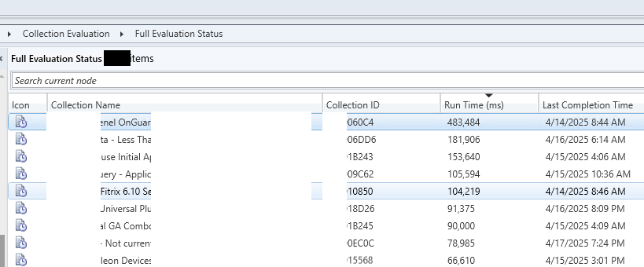
Notes:
Show where Management Insights are in the cm console​
Show where coll eval is in the console, sort by time, etc. (Optionally show in sql where colleval stuff is, may not be able to, that’s more of a ‘large environment’ thing. Doubt my lab will show anything at all.)​
Check for collections where membercount=0 and last memberchangetime was in the distant past, and is NOT a sms* default collection. Consider the need for that collection to stay.​
Check your Incremental Collections.
Easily create randomized ‘ring’ collections using SMSGUID​
Demo a sync'd Intune Collection (and possibly explain why you want to)

Slide 11
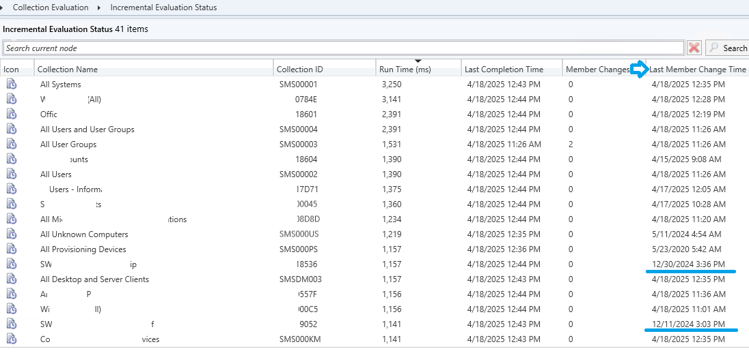
Notes:
Show where Management Insights are in the cm console​
Show where coll eval is in the console, sort by time, etc. (Optionally show in sql where colleval stuff is, may not be able to, that’s more of a ‘large environment’ thing. Doubt my lab will show anything at all.)​
Check for collections where membercount=0 and last memberchangetime was in the distant past, and is NOT a sms* default collection. Consider the need for that collection to stay.​
Check your Incremental Collections.
Easily create randomized ‘ring’ collections using SMSGUID​
Demo a sync'd Intune Collection (and possibly explain why you want to)

Slide 12
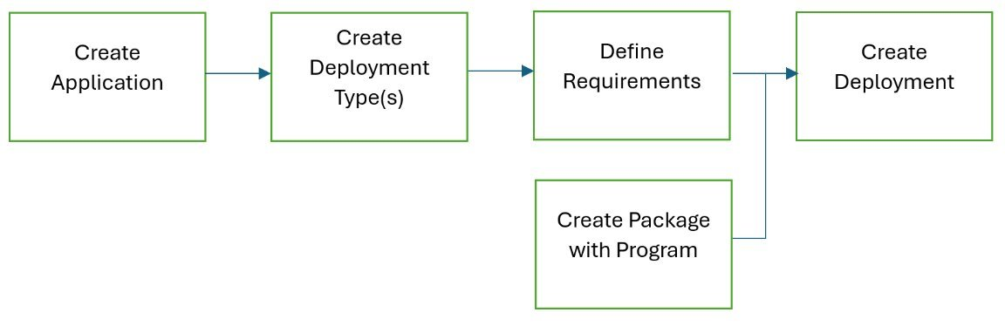
Application (or Classic Advertisement)

Slide 13
Inside an Application
Concepts | Tab | Meaning
Admin Properties | General | Organization and Management
End User Metadata | Software Center | Exposed in Software Center, friendly information visible to users.
Deployment Type | Deployment Types | Framework for the application
Requirement Rules | Within a Deployment Type, Edit, the Requirements Tab | Requirements for a deployment type, this is where you can differentiate a deployment based on criteria, example: x64 vs x86, or Laptop vs. Desktop​​ - Custom Requirements are possible. Create custom ones under Software Library, Applications, Global Conditions
Dependencies | Within a Deployment Type, Edit, the Dependencies Tab | Applications that must be present prior to installing this Application (.net, java, are common examples)
Detection Method | Within a Deployment Type, Edit, Detection Method | What means ‘application is installed’, MSI code, a specific file with a version more than x.x.x.x are examples. Custom scripts (powershell as an example) can also be used. If using a custom script ANY result means a success. So you need to be careful for error handling if using a script.
Install Command | Within a Deployment Type, Edit, Programs | Command Line and Options​​ - Powershell App Deployment Toolkit is an option
Content | Within a Deployment Type, Edit, Content | Source files for the deployment Type

Slide 14
Deployment Flow at a Client
Client Log | Action | Potential errors and what it might mean
PolicyAgent.log | Machine or User Policy Retrieval, Schedule based on policy (available, vs Deadline)
AppDiscovery.log | Is the Application Installed? If yes, done.
AppIntentEval.log | Check Requirements | 0x87D00325 (Requirements Not Met)
CAS.log (Content Access Service) | Detect if content already in client cache (if so, continue directly to AppEnforce.log) Find Distribution Points with Content Submit Content Transfer Manager Job (CTM)
ContentTransferManager.log | Create Data Transfer Service Job (DTS)
DataTransferService.log | Track Download BITS job Created Send Status to Content Transfer Manager | 0x87D00323 (Content Download Error, verify content is on a DP)​​ 0x87D00326 (download failed, check the DP)​​ 0x87D00327 (Bad Source, check paths and access rights)​​ 0x87D01201 (Cache full, adjust cache size or clean cache)
ContentTransferManager.log | Notified of download complete
CAS.log | Notified of download complete
AppEnforce.log (execmgr.log) | Install the application | 0x87D00322 (install failed, review the installation command)
AppDiscovery.log | Verify App is installed according to Detection Method | 0x87D00320, 0x87D00324 (detection logic did not verify success, verify what means detection success in the Deployment Type)
StateMessage.log | Report success or failure

Slide 15
Scenario Basics, what to use
Applications in CM: Re-evaluation, your logic for ‘what means it is installed’ is solid. Content possible.​
Applications in Intune: Content possible.​
Package/Programs in CM: Potentially more useful when exact order of implementation is required (run another program first). Content possible. Solid detection logic not possible.​
Baseline/Configuration item in CM: Re-evaluation frequency important. Content not possible.​
Scripts in CM: Run on demand (or a schedule). Targets only devices online at run time. Content not possible.
Notes:
Package/programs/adverts: Still the best for deploying Driver Updates

Slide 16
Deployment Logs
Bonus: run as System without PSExec
Notes:
Show the Application, and the Package/program, for CMD prompt as system, Powershell as system. Deployed to a user collection, where you are the user (or your team)​
Open up the logs for apps and package flow, show the flow (no content, but still…)​
Apps and Pkg export included in downloads​
Useful for testing an install “as system”. Also potentially useful for t-shooting at a client.

Slide 17
ConfigMgr Configuration Items
Configuration Items (CIs)
Think of Configuration Items as individual building blocks used to define system settings, compliance rules, or application settings.
They can check OS configurations, security settings, registry keys, files, or application settings.
Each CI has defined parameters—like versions, expected values, or compliance rules—to monitor deviations.
Can be used standalone or grouped into Baselines for broader enforcement.

Slide 18
ConfigMgr Configuration Baselines
Configuration Baselines
A Baseline is a collection of CIs bundled together to enforce compliance across devices.
Used to ensure systems meet security policies, performance standards, or regulatory requirements.
Admins can set Baselines to monitor or auto-remediate non-compliant systems.
Deploy Baselines to devices via Configuration Manager Collections to track compliance status.
Helps streamline audits, security enforcement, and operational consistency
Notes:
Why It Matters
Ensures uniform configuration across an enterprise, reducing drift and security risks.
Automates compliance enforcement—saving time and minimizing manual intervention.
Enhances system stability and security by detecting and fixing misconfigurations proactively.

Slide 19
Configuration Baselines (in CM)
Basics​​
Detect only: Registry Key = 1, or 'one of' these values, just report​​
Remediate: If Registry Key <> 1, make it = 1​​
Intermediate to Advanced​​
Run a script repeatedly, simply to populate WMI (for example) for later inventory.​​
Create a script to check 4 things, if 3 of the 4 are good, report compliant. Based on criteria, modify <this text file> and <change this regkey> to get to compliance. ​​
Remember, you cannot deliver 'content'. If your intent is to 'install the latest version of XYZ Software', then you need an Application for the XYZ software, with requirements (possibly custom requirements), and solid Detection Logic (possibly custom script for detection logic)

Slide 20
Microsoft Intune: Remediations & Compliance
Intune remediations help IT admins automatically detect and fix configuration issues on endpoints.
Used to enforce security settings, correct misconfigurations, and ensure devices meet compliance policies.
Powershell scripts return a 0 or a 1
Like ConfigMgr, but simpler, as if we're children.

Slide 21
Intune Cis/Proactive Remediations
Notes:
CIs created in Episode I for IIS.
Intune demo?
Matt, take some pretty screenshots of a live remediation.

Slide 22
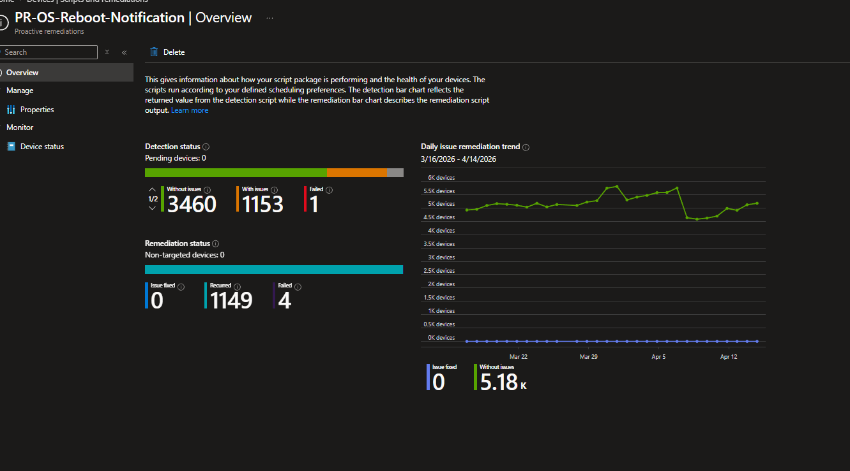
Straightforward one: Check for pending reboot. Use Powershell to present popup. Script based off of: Windows 11 Toast Notification Script - imab.dk
Notes:
Or Matt does live demo with an ARM processing box because he loves it.

Slide 23
Links to Interesting CM Baselines
UpdateCompliance randomizer: CM RefreshServerComplianceState as a Configuration Item​​
Disable Software Inventory Throttling: CM Disable Inventory Throttling​​
Disable Application Deployment Agent and Disable Software Distribution Agent: Selectively Disable Software Distributions and Application Deployments on Clients​​
Custom Hardware Inventory ​​
PerUser installed applications: CM Inventory per-user installed applications​​
Browser Extensions: CM Inventory per-user browser extensions​​
All Members of all Local Groups: CM All Members of All Local Groups​
OS inplace upgrade history: Windows Inplace Upgrade History Inventory

Slide 24
Custom Reporting in CM
Check the Built-in Report first
SSMS (SQL Server Management Studio) is your friend​​
Basic queries​​
Devices which do NOT have xyz Software​​
Custom Inventory results​​
Advanced query​​
Devices that are non-compliance for a CI, and the exact reason why not (if your CI was designed to do so)​​
Client Status (in the console, and reports)​​
System Center Configuration Manager Reporting Unleashed

Slide 25
SQL Server Management Studio Queries
Notes:
{Sherry]
Specifically, non-compliant for a CI, with the reason why​
Admin users​
Per-user installed apps.​
Software NOT installed on … (subselect query)
FastChannel queries (if you want SQL, vs. Looking at the console)
Isonline
Pendingreboot
Script results

Slide 26
Scripts Node and CMPivot
Why FastChannel is cool beans
If for whatever reason you are not 'allowed' to install the Right-Click Tools, some things can be done via Script node. Examples (code will be provided in session downloads)​​
Full Hardware Inventory Request​​
Refresh Updates Compliance State​​
Group Policy Update​​
Reboot –force​​
Run any Client Action​​
Don't forget about CMPivot!​​
SCCM CMPivot Query Examples​​
CMPivot sample scripts | Microsoft Learn​​
GitHub - svschmit/CMPivot-Queries: Collection of helpful CMPivot Queries​
Notes:
Scripts node script examples in session downloads.

Slide 27
Scripts and CMPivot
Notes:
TCSMUG - Twin Cities Systems Management User Group - Use CM Console scripts node to gather log files from CM Clients

Slide 28
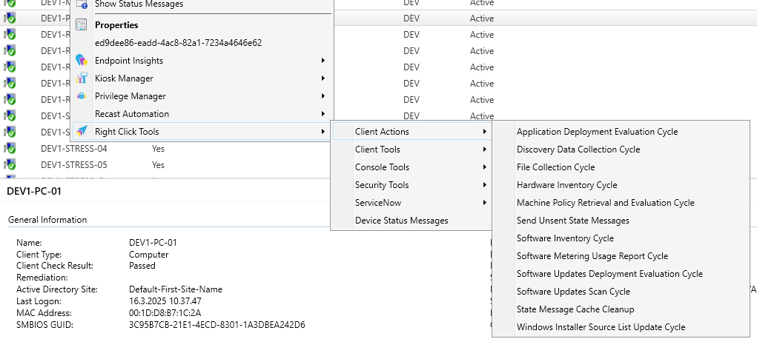
Recast Right-Click Tools
https://www.recastsoftware.com/free-tool-download/
https://ideas.recastsoftware.com/?sort=recent

Slide 29
Console Right-click
Notes:
Scripts against active/online clients.
CMPivot against active/online clients.
Garth and Recast community right-click.

Slide 30
Client Settings
Like GPO's But Different
Resultant Client Settings are your Friend
Reboots – Everyone does it

Slide 31
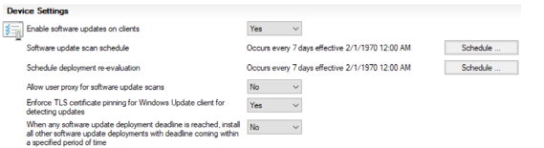
Software Updates
Software Update Scan Schedule – STOP DDOSING YOURSELF
Anytime a NEW software update group is assigned AND machine policy Runs
Anytime a scheduled instance of Software Update Scan Schedule Hits
Anytime a Deployment is completed
Sometimes after a reboot is completed - Depends on assignment configuration
After a servicing stack update https://docs.microsoft.com/en-us/mem/configmgr/sum/plan-design/plan-for-software-updates#bkmk_ssu

Slide 32
Helpful Links
Troubleshooting Hardware Inventory Flow in CM​​
Community Tools​​
Recast Right-click Tools for CM and Intune​
Client Center for Configuration Manager

Slide 33
Educational Resources
Read and summarize the following https://learn.microsoft.com/en-us/intune/configmgr/ including all links and subpages.
The Fundamentals - https://learn.microsoft.com/en-us/intune/configmgr/core/understand/fundamentals
The Learning - https://learn.microsoft.com/en-us/training/browse/
The certs. https://arch-center.azureedge.net/Credentials/Certification-Poster-en-us.pdf

Slide 34
Forums
Discord ConfigMgr https://discord.com/channels/618712310185197588/618713403518615552
Reddit https://www.reddit.com/r/SCCM/new/, https://www.reddit.com/r/intune/new/
Prajwaldesia https://forums.prajwaldesai.com/
Windows Noob https://www.windows-noob.com/forums/
MS TechCommunity Hub https://techcommunity.microsoft.com/category/microsoftintune/discussions/configurationmanager
MS Q&A https://learn.microsoft.com/en-us/answers/tags/417/configuration-manager

Slide 35
Social Media you should follow
https://bsky.app/profile/andrewj.net - Author of the MMS session download script
Bluesky MMSMOA Starter Pack – From Matt Zaske
Modern Endpoint Management – LinkedIn
The social media handles of all the amazing speakers you’ll see this week
Old fashioned social interaction – Local user groups
https://tcsmug.org/misc/other-user-groups

Slide 36
See Wally, he’ll find a mutual time for us to meet!

